Slide 1

“Sports” I’d like to see added to the Olympic Games

Slide 2
Bo-taoshi (Bring Down the Pole)

Slide 3
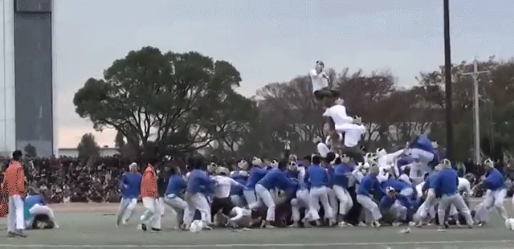
Bo-taoshi (Bring Down the Pole)

Slide 4

Bo-taoshi (Bring Down the Pole)
1:39

Slide 5
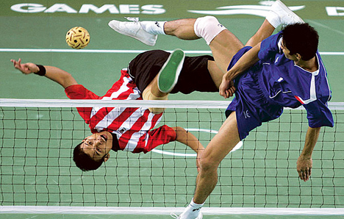
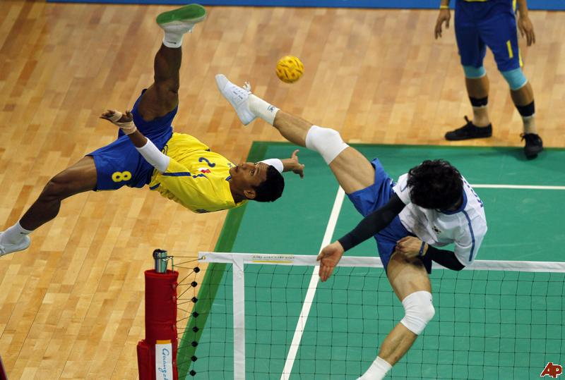
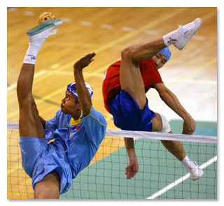
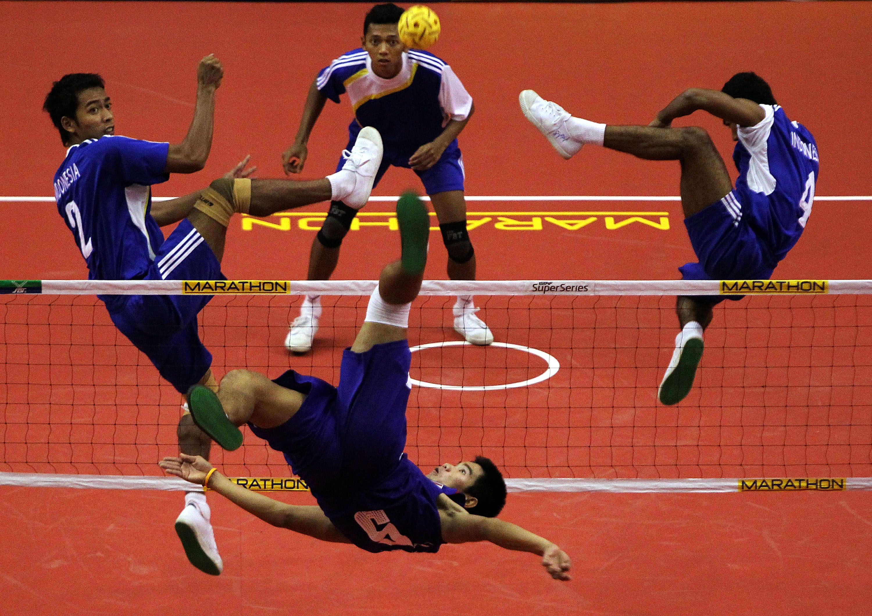
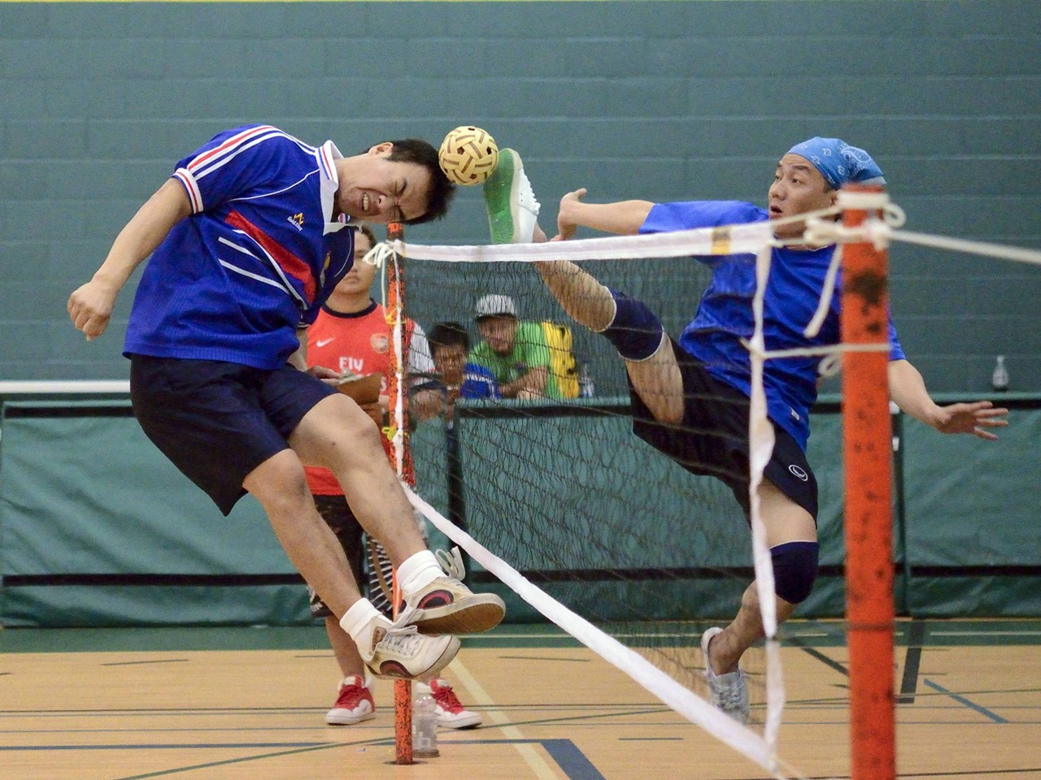
Sepak Takraw (Kick Ball)

Slide 6

Sepak Takraw (Kick Ball)
0:05

Slide 7
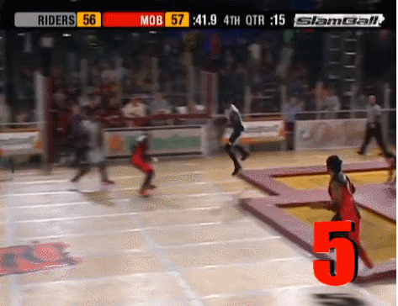
Slam Ball (Trampoline Basketball)

Slide 8
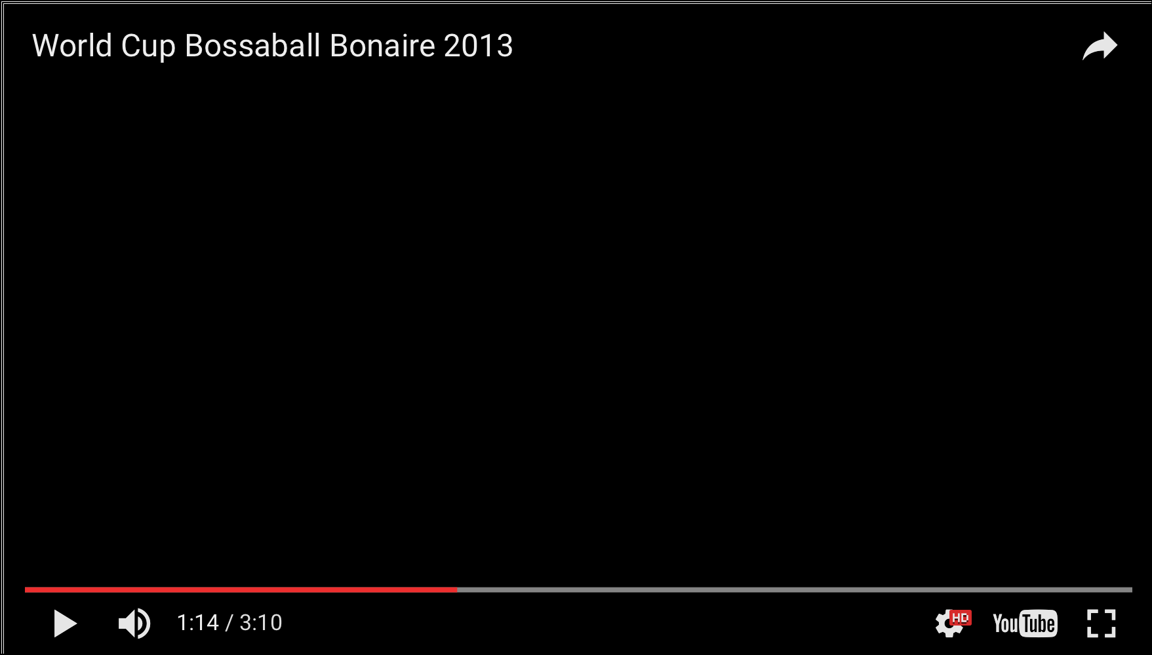
Bossaball (Trampoline Volleyball)
0:56

Slide 9
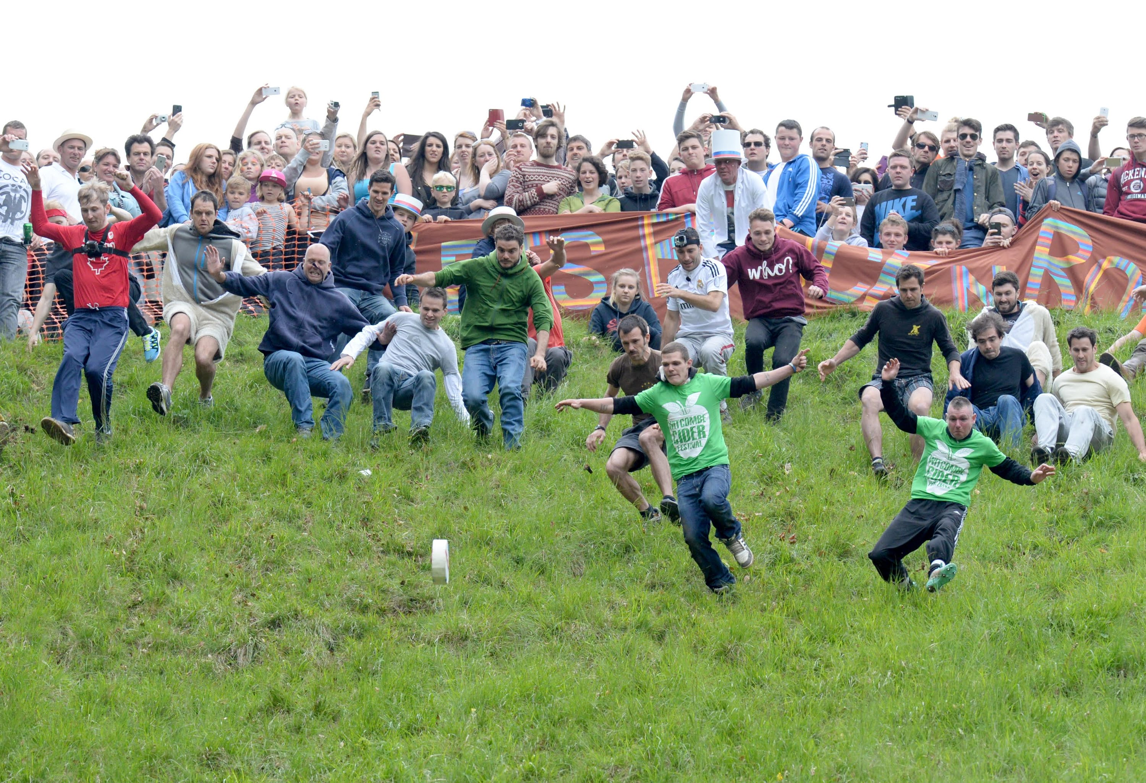
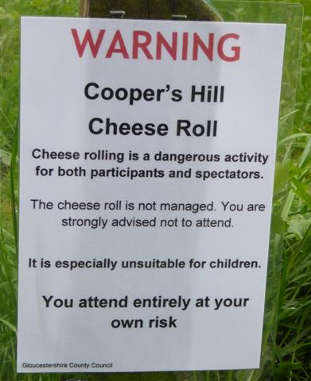
Cheese Rolling

Slide 10

Cheese Rolling
0:35

Slide 11
Hornussen (Golf + Baseball)

Slide 12
Hornussen (Golf + Baseball)

Slide 13
Octopush (Underwater Hockey)

Slide 14

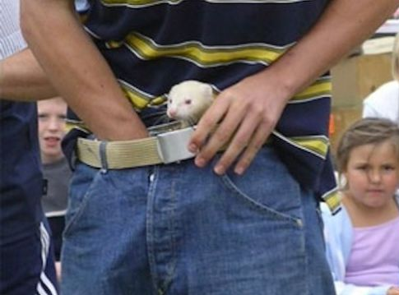
Ferret Legging
How long can you keep 2 angry ferrets in your pants?

Slide 15
Extreme Ironing

Slide 16
Fierljeppen (Canal Vaulting)

Slide 17
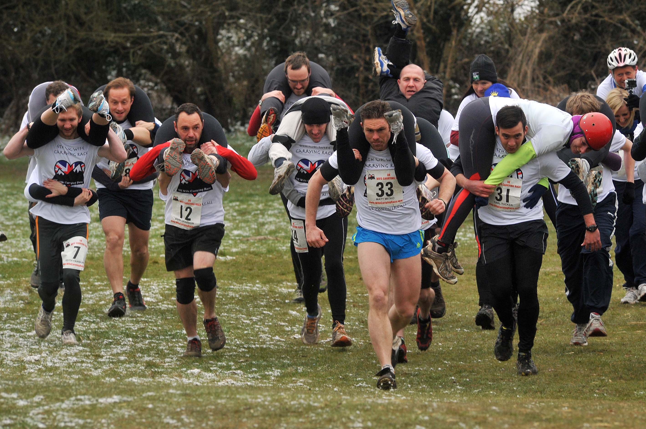
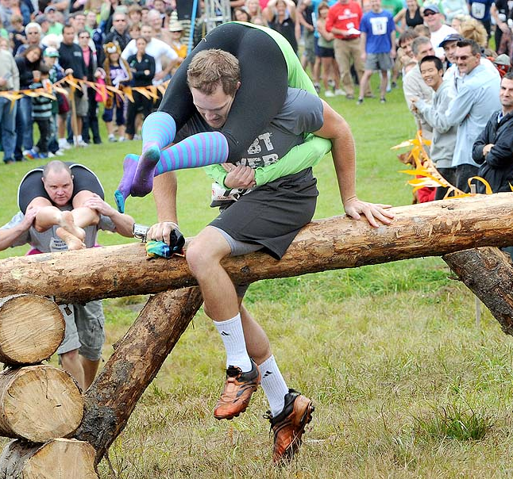
Eukonkanto (Wife Carrying)

Slide 18
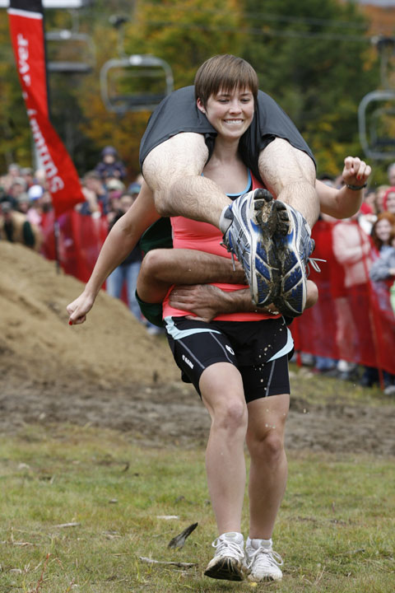
Husband Carrying

Slide 19
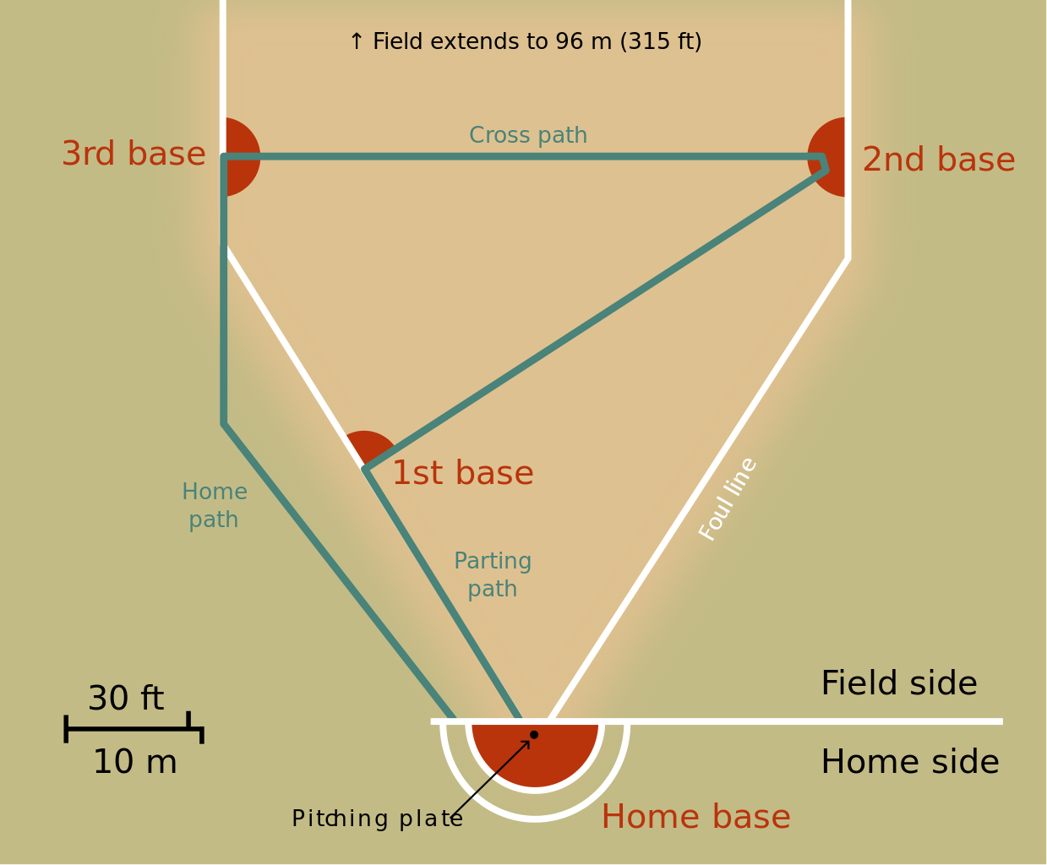
Pesapallo (Finnish Baseball)

Slide 20
Buzkashi (Goat Grabbing)

Slide 21
More Sports
Kabaddi (Tag + Wresting)
Chess Boxing
Toe Wrestling
Hurling
Dwile Flonking (??????)
Shin Kicking
Kite Tubing
Extreme Saunaing

Slide 22
Questions?

